Slide 1

PRESENTED BY:
Raul Arcangelo, Javier Guirao, Preeya Singh Chauhan &
Meenu Saini

Slide 2
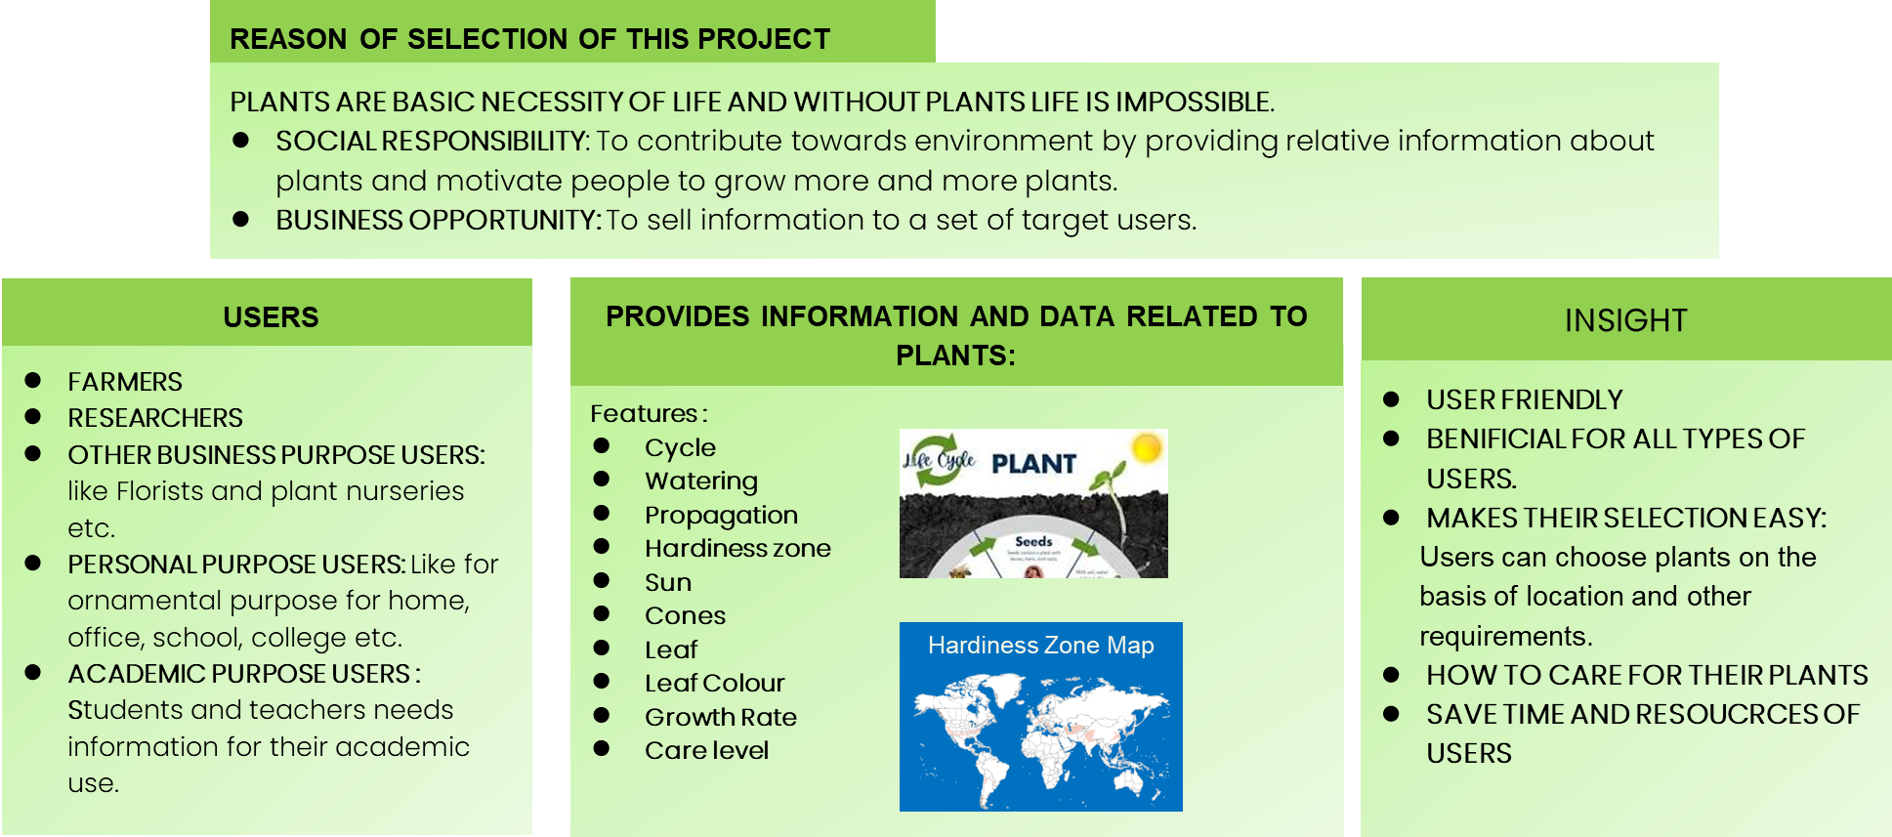
BUSINESS IDEA

Slide 3
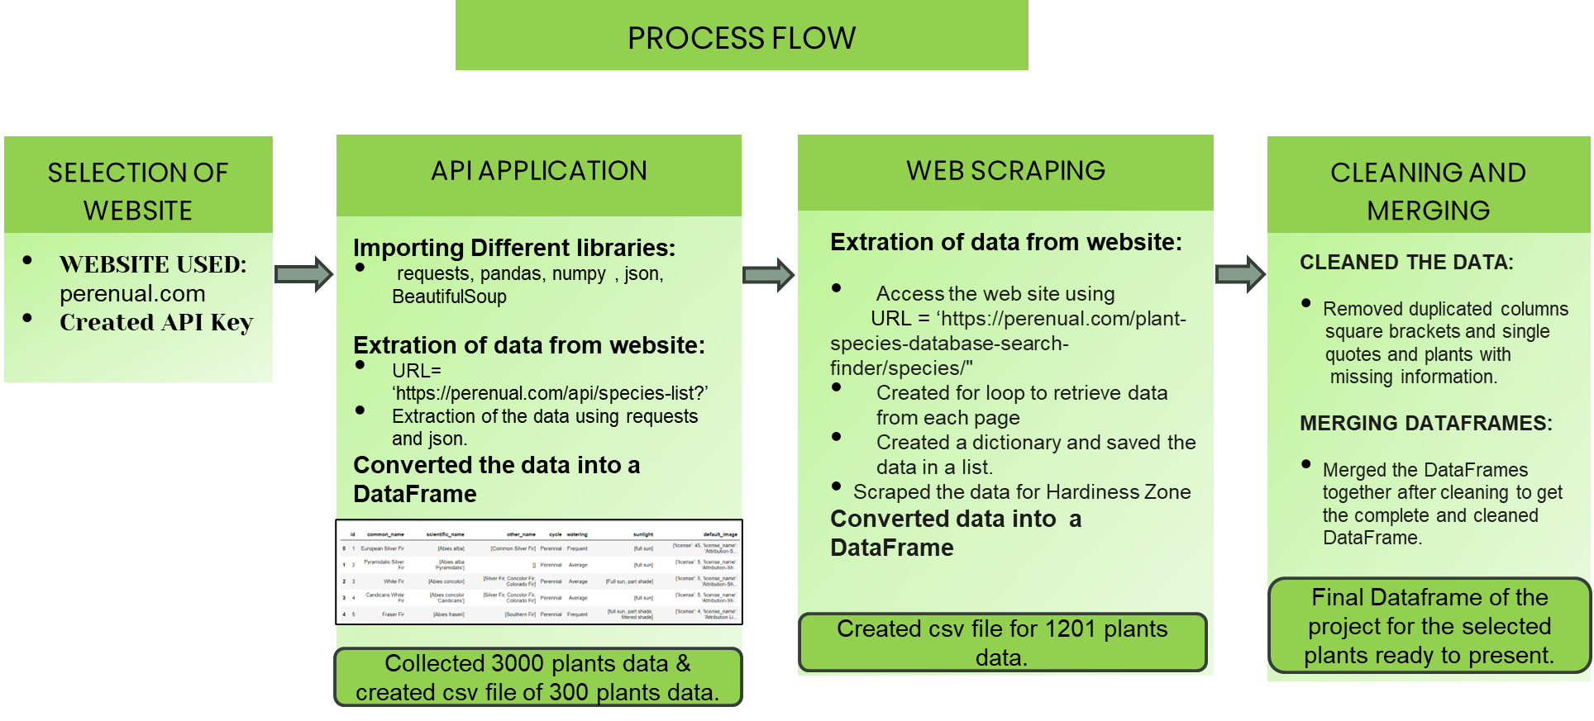
TECHNICAL DEVELOPMENT

Slide 4
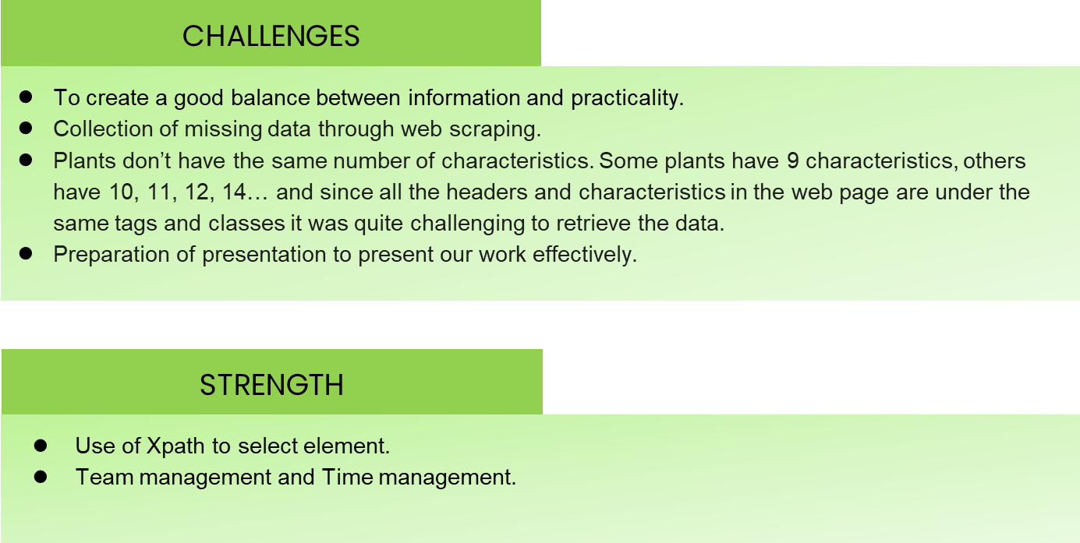
CHALLENGES AND STRENGTH

Slide 5
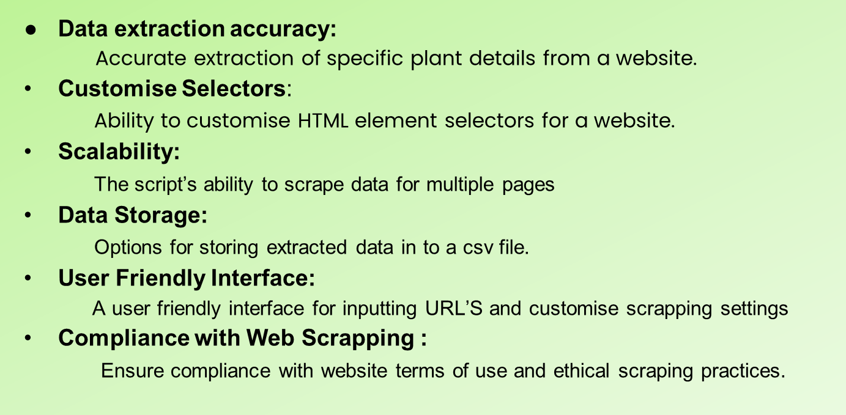
PRODUCT FEATURES

Slide 6
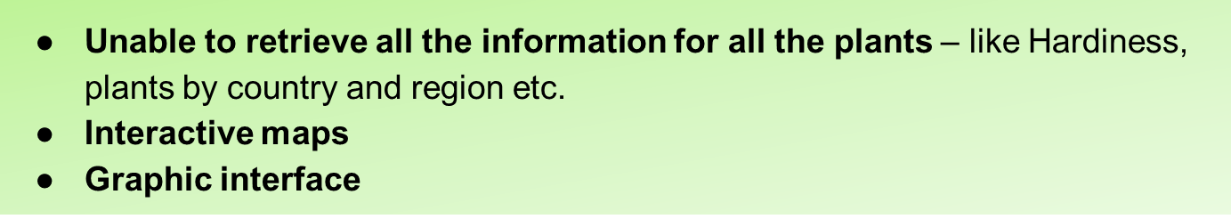



Slide 7
Thank you!
LINKS:
Jupyter Notebook
Trello planning

